Slide 1
Inspiring Future Generation’s Career Choices
Cath Longhurst
CEO
EBP South and Basingstoke Consortium

Slide 2
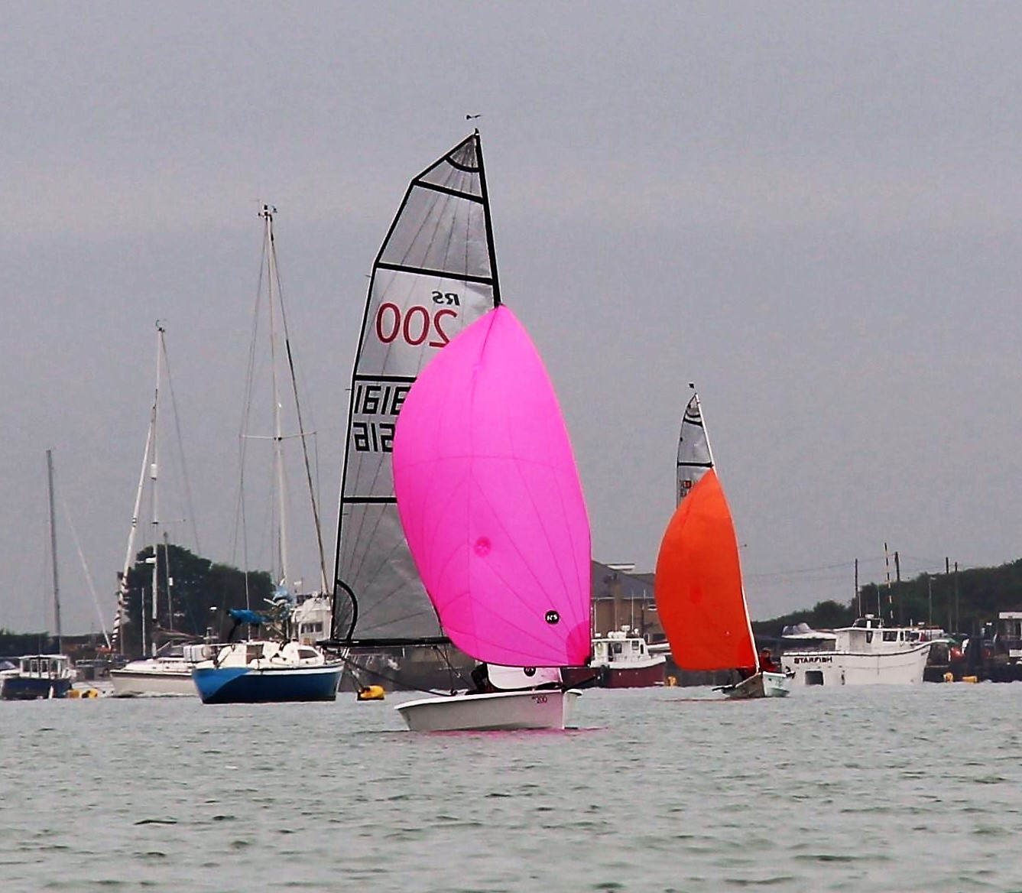
Working across Hampshire, Portsmouth, Southampton and IOW:
Work Experience
Careers Guidance in Schools
Career Inspiration Activities – Big Bang, Teentech, Primary STEM
Career Preparation – employability skills

Slide 3
Moments of Choice
Cognitive burden
Personalised information
Key influencers
Perceiving the future
Power of meeting people
Importance of real work experiences
Careers and Enterprise Company

Slide 4
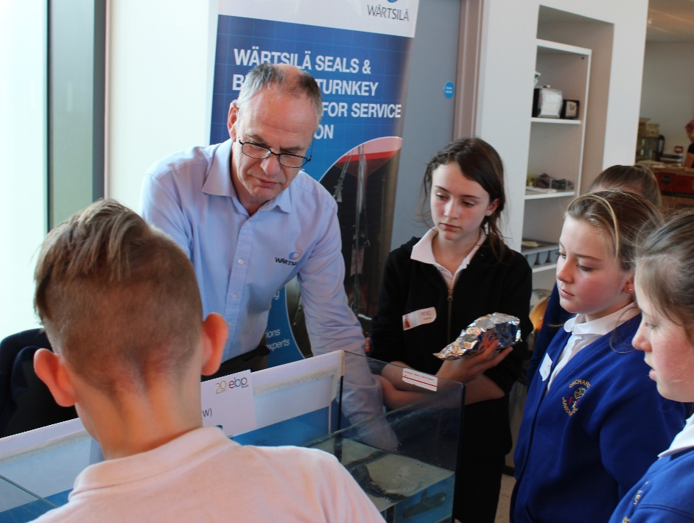
‘Drawing the Future’:
Perceptions about certain jobs formed at early age
Aspirations shaped by who they know
Gender stereo-typing
STEM-related professions featured – vet, doctor, scientist and engineer (civil, mechanical, electrical)
Educationandemployers

Slide 5
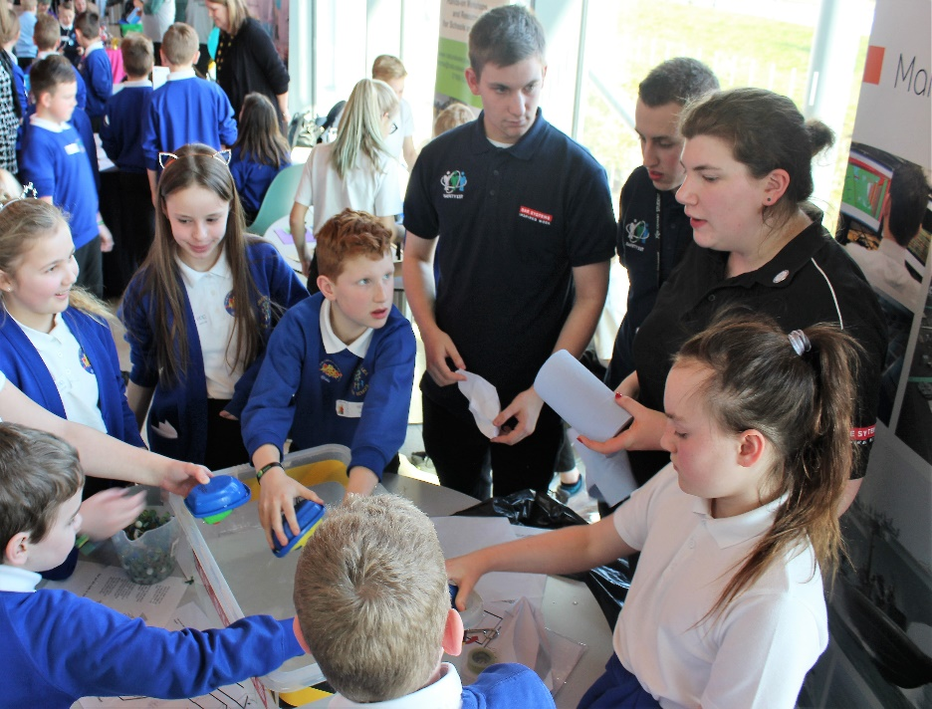
Careers In Schools
New Careers Strategy
Gatsby Benchmarks
Importance of meeting people from workplace
Professional advisers to guide at critical points
Role of Enterprise Advisers

Slide 6
Examples of current initiatives
Enterprise Adviser Network and ABP Ports
1851 Trust Next Generation Roadshow
EBP South Primary STEM Fair

Slide 7
Competing for future talent:
Construction, healthcare, aerospace, advanced manufacturing, digital & creative
Having a presence on ‘general’ careers websites
Finding ways for the sector to take part in existing initiatives

Slide 8
Useful resources and links
www.ebpsouth.co.uk
www.careersandenterprise.co.uk ‘Moments of Choice’
www.educationandemployers.org ‘Drawing the Future’
www.1851trust.org.uk
www.teentech.com
www.thebigbangfair.co.uk
www.stem.org.uk/stem-ambassadors
General careers websites:
www.notgoingtouni.co.uk
https://icould.com/
http://website.u-explore.com/
https://nationalcareersservice.direct.gov.uk
Cath Longhurst: clonghurst@ebpsouth.co.uk

